Slide 1

Predicting Congressional Election Outcomes
BY GABRIEL VALLADARES AND CONRAD MITCHELL

Slide 2
Our Problem
Analyze the demographic data of precincts in North Carolina and use that data to predict the results of the elections.
Determine which classifier to use in order to best predict the outcomes of elections.
Determine if demographic data is a significant predictor of election results.
Notes:
Conrad

Slide 3
Our Approach
Gather data on the precinct level
Demographic data
Election results from elections that took place from 2004-2012
Clean the data
Run the data through a nearest neighbor classifier
Analyze the results
Notes:
Gabe

Slide 4
Cleaning the Data
The data used in this project:
Congressional Election Results of each precinct in North Carolina
https://www.ncsbe.gov/election-results
Demographics of each precinct
data2.nhgis.org
Cleaning the data
Different election years had different formats
Connecting the election results from each precinct to the demographics from that precinct
Similarity analysis to match keys
Notes:
Conrad

Slide 5
Features
We used the demographic data from each precinct within North Carolina as the features of our classifier.
Demographic Features:
Race, Gender, Age
Outcome
The outcome that we tested with was whether a precinct voted for a Republican or a Democratic candidate
Notes:
Gabe

Slide 6
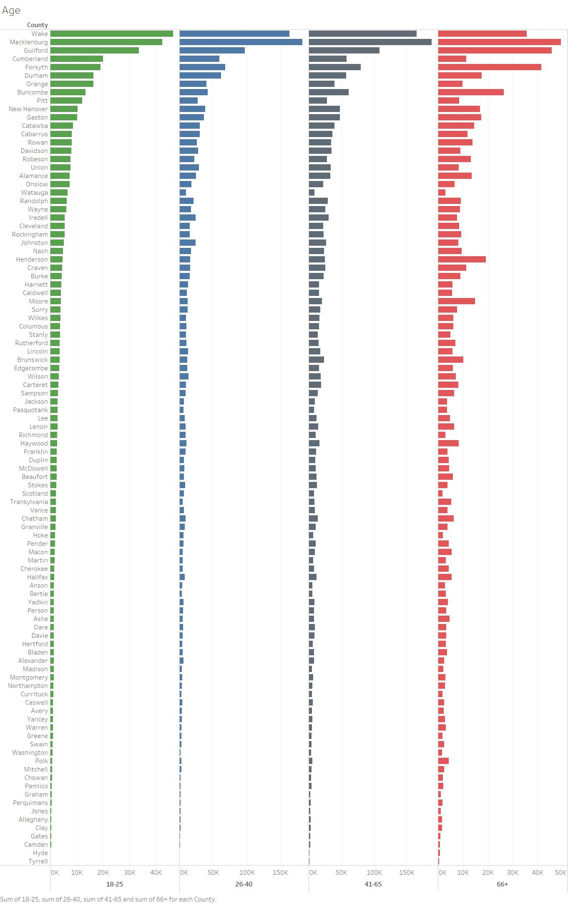
Demographic data visualized - age
Notes:
Gabe

Slide 7
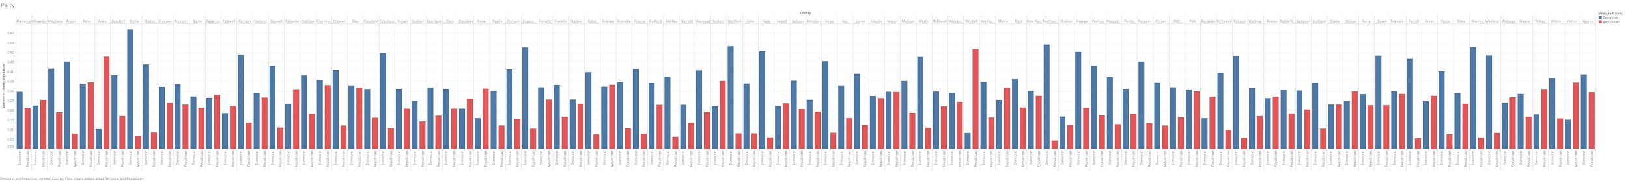
Demographic data visualized - Party Affiliation
Notes:
Gabe

Slide 8
Demographic data visualized - Race
Notes:
Gabe

Slide 9
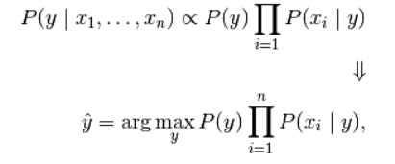
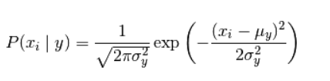
The Classifiers
This project examined two types of classifiers that attempted to predict election results based on demographic data.
Two Classifiers:
Naive Bayes
Nearest Neighbor
Notes:
Gabe

Slide 10
Results - Nearest Neighbor
We decided that based on the amount of data that we had and the type of the data to use a nearest neighbor classifier with k=9
We ran the algorithm across three different elections
Results
2004 Election:
Training Accuracy: 0.8405
Testing Accuracy: 0.7887
2006 Election:
Training Accuracy: 0.7923
Testing Accuracy: 0.7304
2008 Election:
Training Accuracy: 0.7761
Testing Accuracy: 07271
Notes:
Gabe

Slide 11
Results - Naive Bayes
In addition to running the nearest neighbors classifier, we also used a Gaussian Naive Bayes Classifier in order to examine which classifier would perform better with these data sets
Results
2004 Election
Train Accuracy: 0.7379
Test Accuracy: 0.7302
2006 Election
Train Accuracy: 0.6187
Test Accuracy: 0.6357
2008 Election
Train Accuracy: 0.6308
Test Accuracy: 0.6441
Notes:
Gabe

Slide 12
Naive Bayes vs Nearest Neighbor
Comparison of Bayes vs Nearest Neighbor classifiers using the average accuracies across the three elections:
 | Naive Bayes | Nearest Neighbors
Training Accuracy | 0.6625 | 0.8030
Testing Accuracy | 0.6700 | 0.7487
Notes:
Gabe

Slide 13
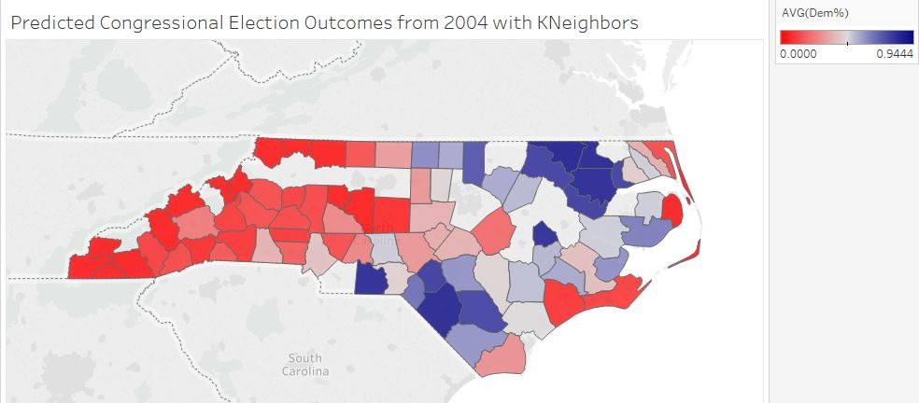
Precinct/County Breakdown
Notes:
Conrad

Slide 14
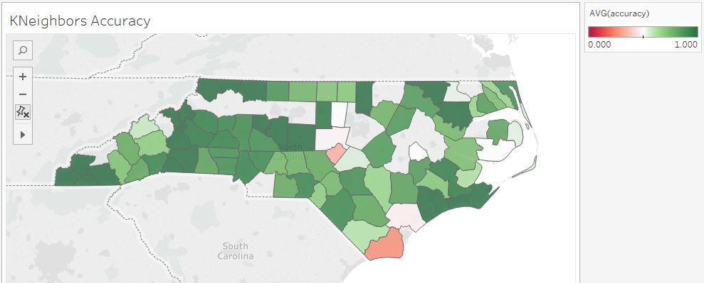
Precinct/County Breakdown
Notes:
Conrad

Slide 15
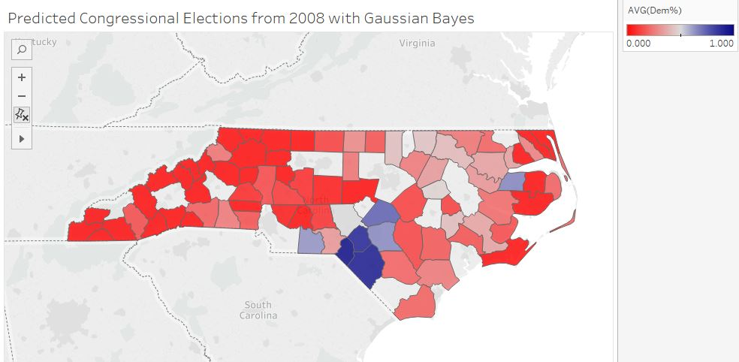
Precinct/County Breakdown
Notes:
Conrad

Slide 16
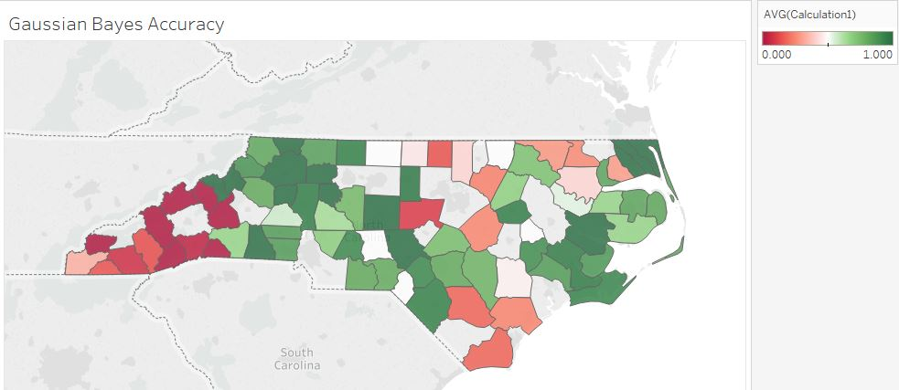
Precinct/County Breakdown
Notes:
Conrad

Slide 17
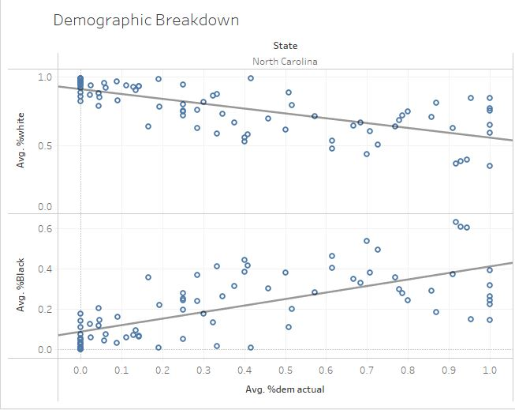


Relevant Features
Race demographic features proved to be the most significant predictors of election outcomes
Notes:
Conrad

Slide 18
Unresolved Issues
Originally, we wanted to include more features in our predictors such as income but we were unable to find that data.
There are many features related to elections that we were not able to measure in this project such as how a representative’s incumbency might affect their chances at winning.
We were only able to analyze based on static demographic results as censuses only occur every 10 years
It might have improved our accuracy to see how changing demographics affected outcomes, however, we did not have access to more data.
Notes:
Conrad

Slide 19
Conclusions
Based on our analysis, demographic data is a useful measure when trying to determine the election results of precincts in North Carolina
Congresspeople can thus use this data in order to gerrymander districts in such a way that would benefit them.
Notes:
Gabe

